Slide 1
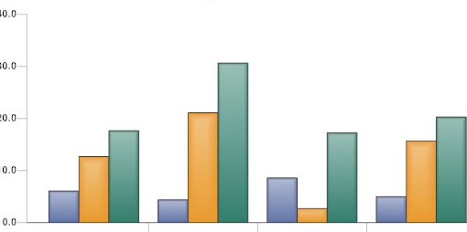



Hospital Information Dashboard
Powered by
A dashboard to compare patienty safety and quality measurements as compared to national benchmarks
Datasets are derived from public datasets and stored in a pandas dataframe
Goal is to pull this data together in one site for a simple comparison of a chosen hospital
DATA RESOURCES:
Acknowledgements:
https://www.kaggle.com/paultimothymooney/how-to-query-the-medicare-dataset/notebook
https://github.com/jvns/pandas-cookbook
https://github.com/plotly/dash
https://github.com/plotly/plotly_express
Coding and design by: Bonnie McDaniel

